Slide 1
Book Recommendation System
Done by:

Slide 2
Bussiness Objective
Generate the features from the dataset and use them to recommend the books accordingly to the users.

Slide 3
Dataset Details
The Book-Crossing dataset comprises 3 files.
Users
Contains the users. Note that user IDs (User-ID) have been anonymized and map to integers.
Demographic data is provided (Location, Age) if available. Otherwise, these fields contain NULL-values.
Books
Books are identified by their respective ISBN. Invalid ISBNs have already been removed from the
dataset. Moreover, some content-based information is given (Book-Title, Book-Author, Year-
Of-Publication, Publisher), obtained from Amazon Web Services. Note that in case of several
authors, only the first is provided. URLs linking to cover images are also given, appearing in three
different flavours (Image-URL-S, Image-URL-M, Image-URL-L), i.e., small, medium, large. These
URLs point to the Amazon web site.
Ratings
Contains the book rating information. Ratings (Book-Rating) are either explicit, expressed on a
scale from 1-10 (higher values denoting higher appreciation), or implicit, expressed by 0.

Slide 4
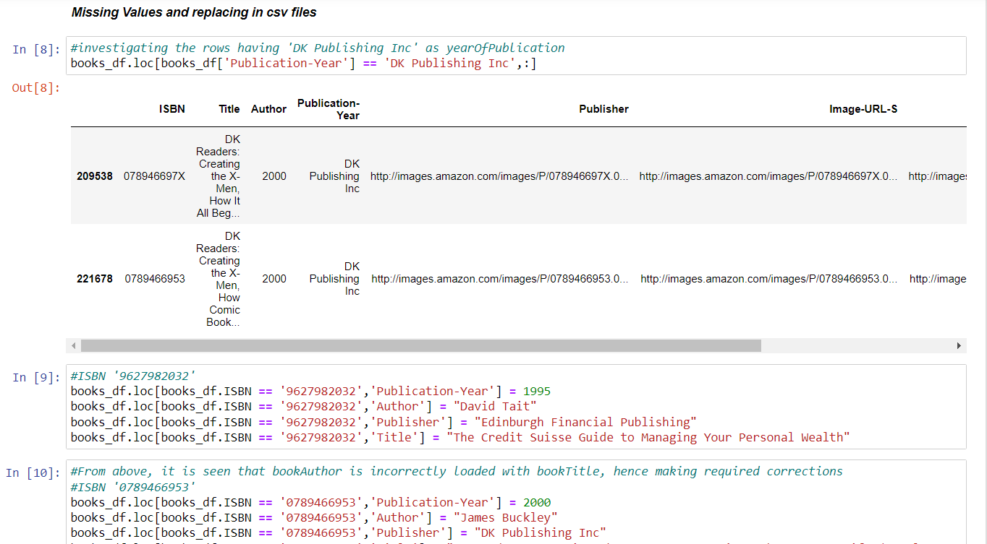
Exploratory Data Analysis

Slide 5
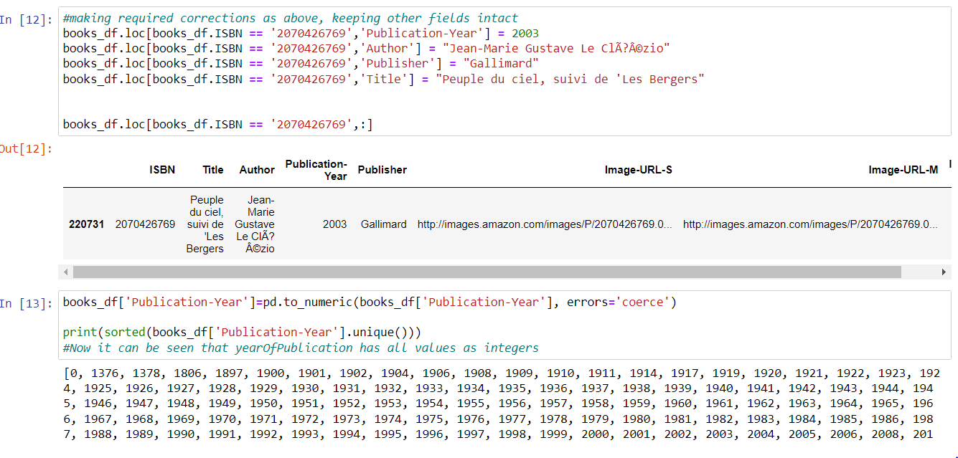
EDA Contd..

Slide 6
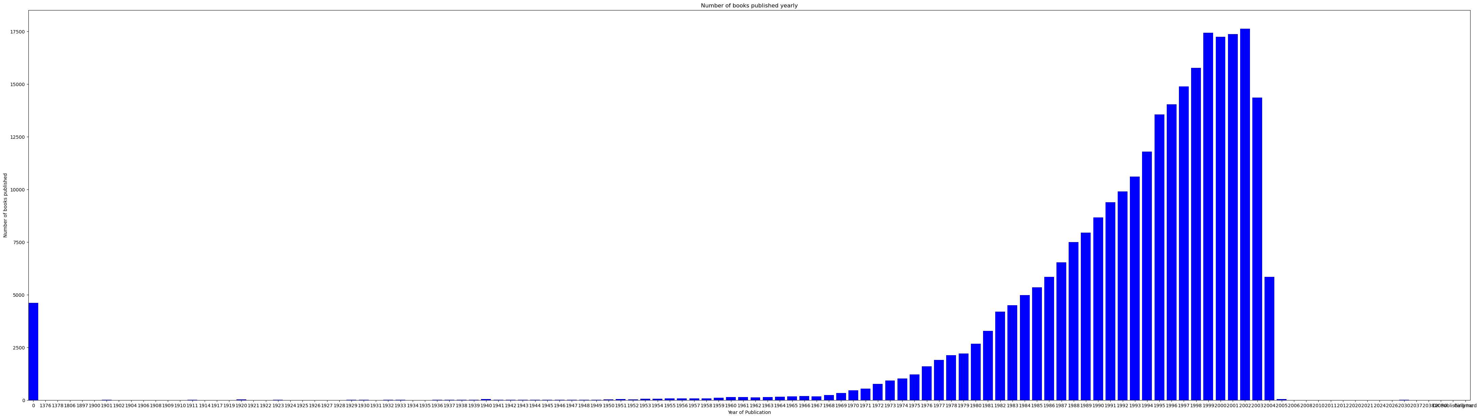
Visualizations

Slide 7
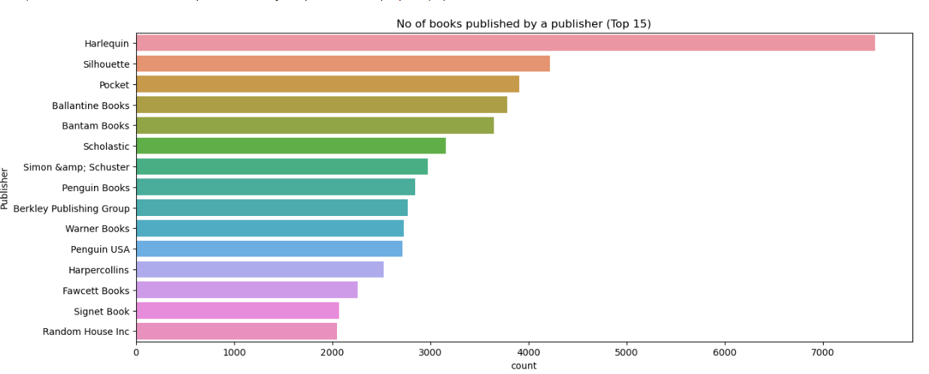
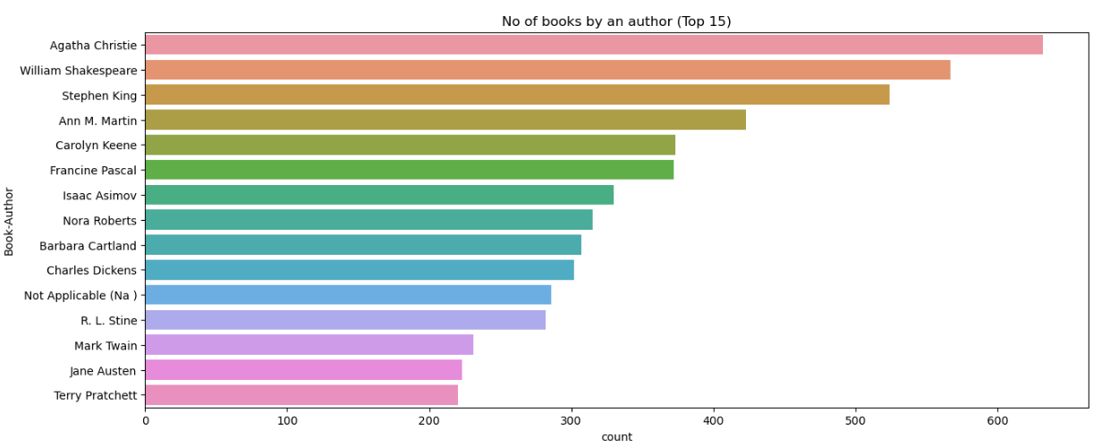

Slide 8
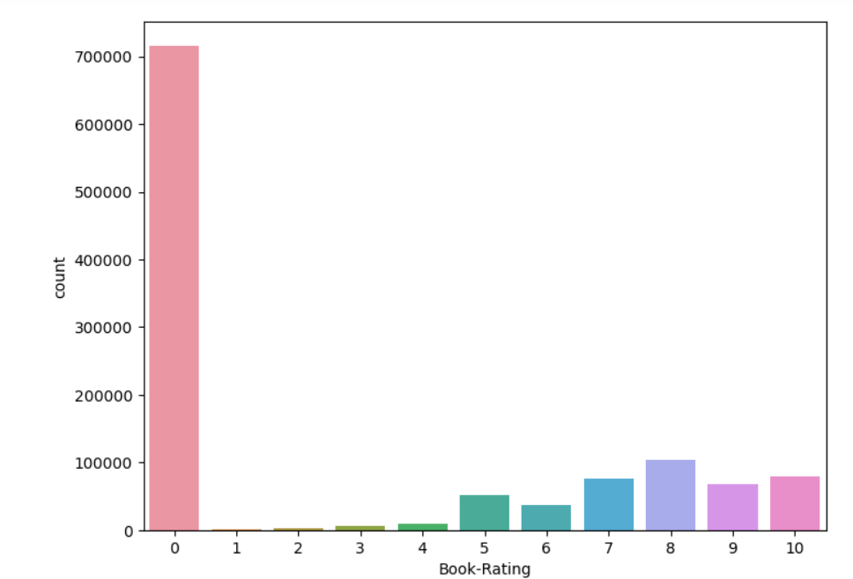

Slide 9
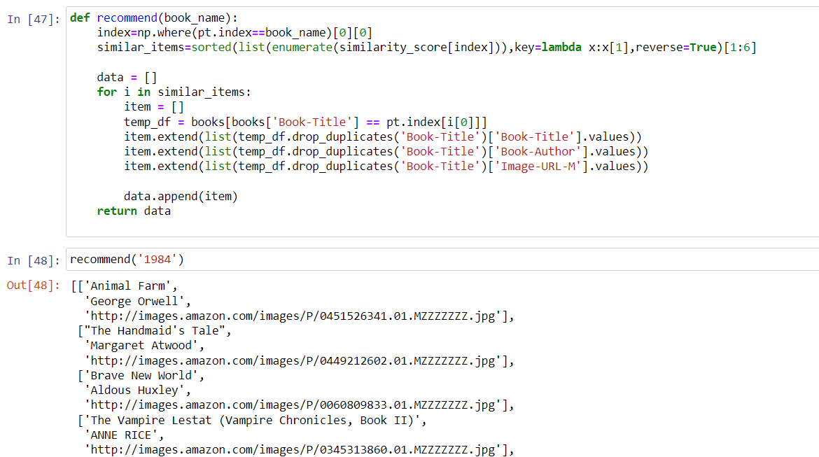
Model Building

Slide 10
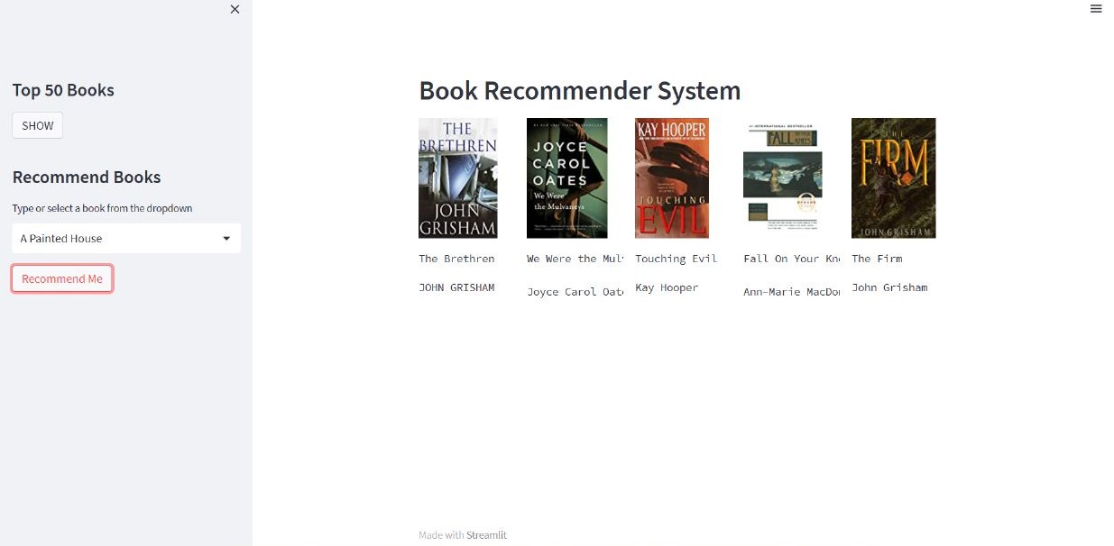
Deployment

Slide 11
Thank You

